Slide 1
Fundamentals of Machine Learning Week 1: data and distributions
Jonas Moons
All images are either own work, public domain, CC-licensed or fair use
Credits on last slide

Slide 2
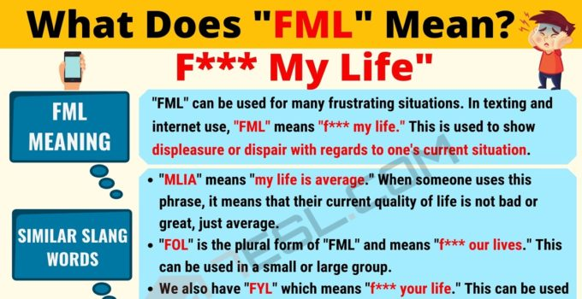
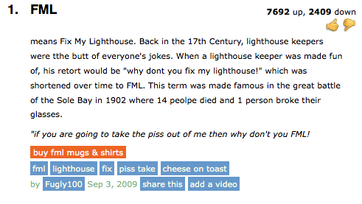

Slide 3

My background
BSc in AI, MSc in Cognitive neuroscience, course at London School of Economics
Market research
PubLab: methodological/statistical adviser
Interest: understanding human behavior through statistics and machine learning
Please use Teams channel for questions more people might have, and e-mail for personal questions (not chat)

Slide 4
Schedule
Wednesday
Course overview & data cleaning | 14:00-14:45
Short break | 14:45-14:50
Exercise 1 + solution | 14:50-15:45
Break | 15:45-16:00
Distributions | 16:00-16:30
Exercise 2 + solution | 16:30- (ca) 17:30/17:45
Friday
Course overview & data cleaning | 9:30-10:15
Short break | 10:15-10:20
Exercise 1 + solution | 10:25-11:15
Break | 11:15-11:30
Distributions | 11:30-12:00
Exercise 2 + solution | 12:00- (ca) 13:00/13:15

Slide 5
Topics
Example
Course overview
Data cleaning and ‘munging’
Distributions
Sampling and the normal distribution

Slide 6
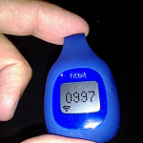
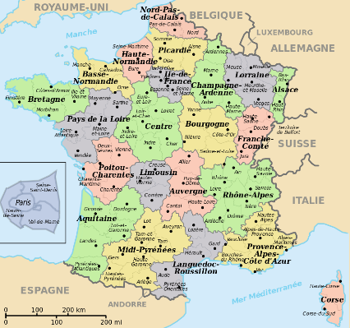

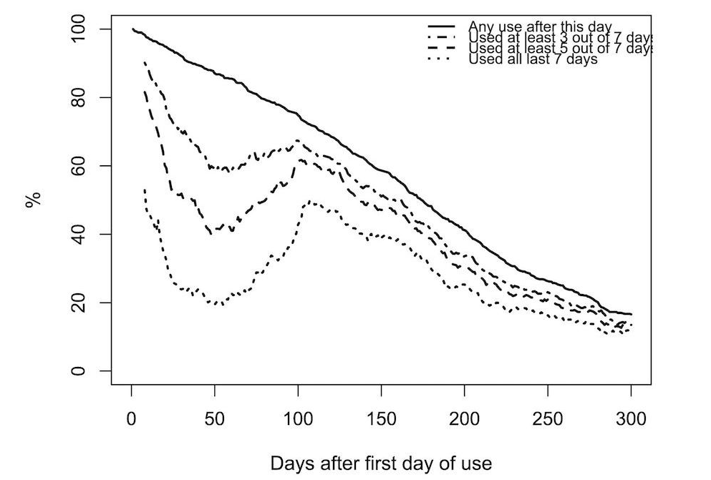

Example: modelling activity tracker usage with Random Forest
JMIR paper

Slide 7
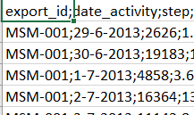
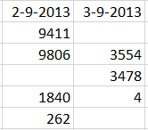
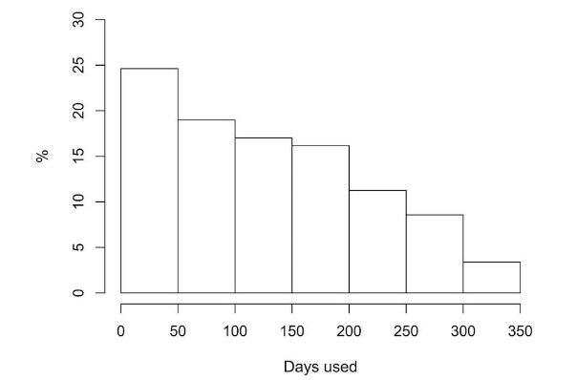
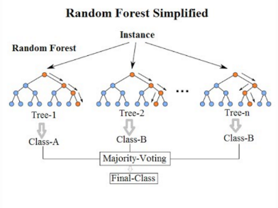
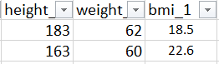
The data science cycle
Data cleaning
Exploratory data analysis / visualization
Feature engineering
Model building and evaluation
Practical application

Slide 8
Course overview
Similar set-up to Fundamentals of Data Science
Portfolio of weekly assignments
Final assignment: building a predictive model
Please post your exercises on Teams (link to your solution on GitHub)
Note: slides and exercises are on GitHub
We’re working in Jupyter Notebook

Slide 9
Final assignment
Build a predictive model to predict user data
Data set has to be new, e.g.
Scraping
Own data or own platform data
Collaboration with company (make sure you comply with GDPR)
Collaboration with research group AI
Online symposium in week 9

Slide 10

AI research group
Partnership with research group on AI
Possibility for a small number of ambitious students to do final assignment participating in research group and (partly) supervised by AI researcher
See website (in Dutch, but you can look at publications)
Interested? Contact me

Slide 11
Schedule
Week | Topics
1 | Data and distributions
2 | Exploratory data analysis
3 | Linear regression
4 | Machine learning
5 | Machine learning
6 | Text mining
7 | Unsupervised learning
8 | Work in class on project / to be determined
9 | Work in class on project Poster presentations Deadline

Slide 12
Topics
Example
Course overview
Data cleaning and ‘munging’
Distributions
Sampling and the normal distribution

Slide 13
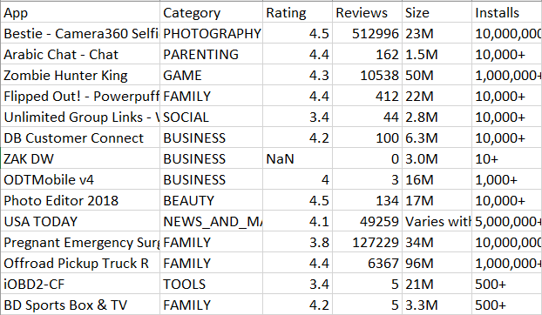
Terminology
Quantitative variable
Case
Qualitative variable: nominal
Factor (statistical model)
Categorical (Pandas)
Qualitative variable: ordinal
(Also: school types, army ranks)

Slide 14
Common problems
Wide form and long form
Missing values and the way they are coded
File encoding issues
Text encoding issues
Date/time issues
Outliers
Faulty data entry
It’s very useful to learn regular expressions (patterns in text) to clean up data

Slide 15

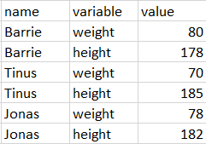
Wide form and long form
Wide form is the most typical and preferred for research: each variable has a column, each case a row
Long form is also common: each variable has a row

Slide 16
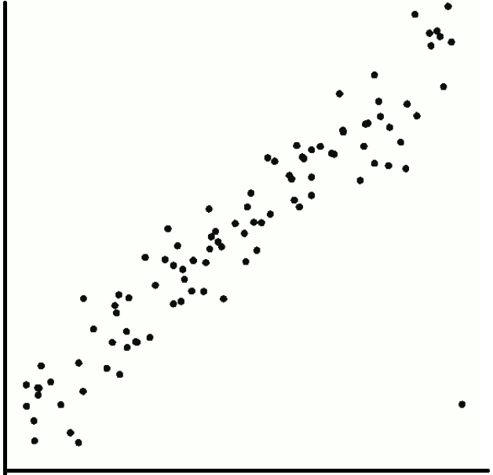
Outliers
Outliers lie far outside the trend
Outliers may indicate faulty data
They may also be interesting edge cases
They may also influence your models (too) strongly, or indicate limitations of your model
Inspect the outliers. Generally only remove with good reason

Slide 17
Exercise 1: data cleaning
See example Notebook: data_cleaning
Combine the two files from the Fitbit project steps and survey data) into a single csv file, and clean up the variable weight. You will also need these cleaned data for the weekly assignment.
You will run into several issues. Try and solve them. Here are some hints:
Different world regions use different encodings. How do you see this in the files? Look in the documentation of pd.read_csv() to load both files correctly.
Which variable is the key to combine both files?
Are all values of weight plausible? What are you going to do about this?

Slide 18
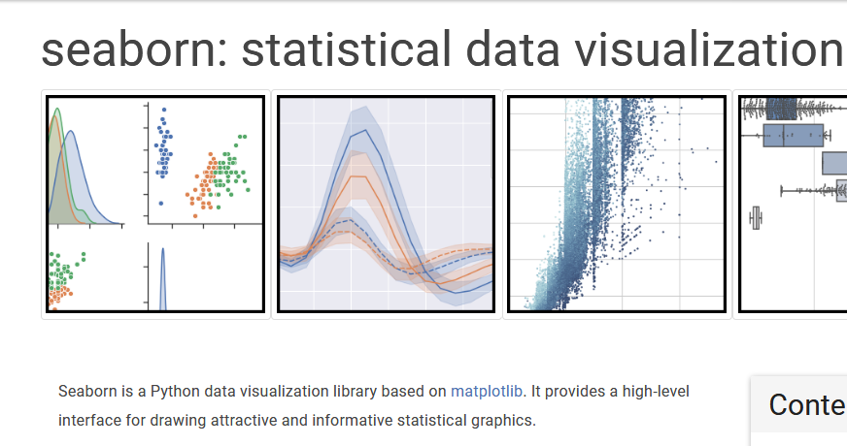
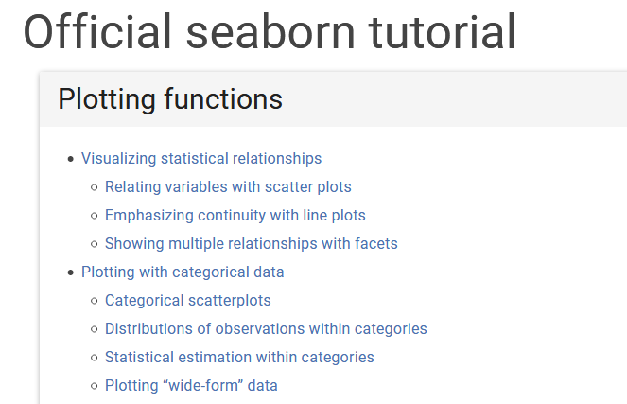
Seaborn
Tutorial

Slide 19
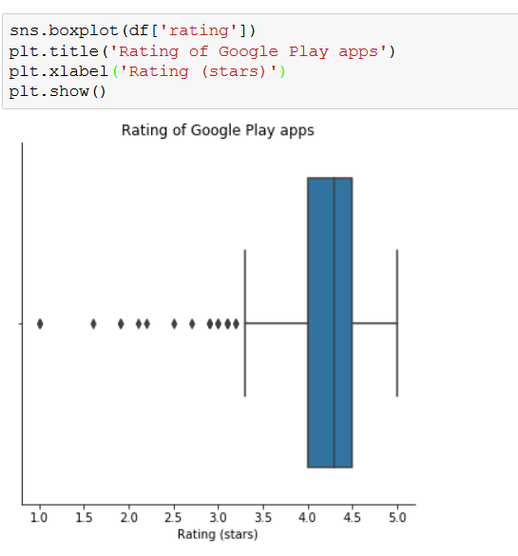
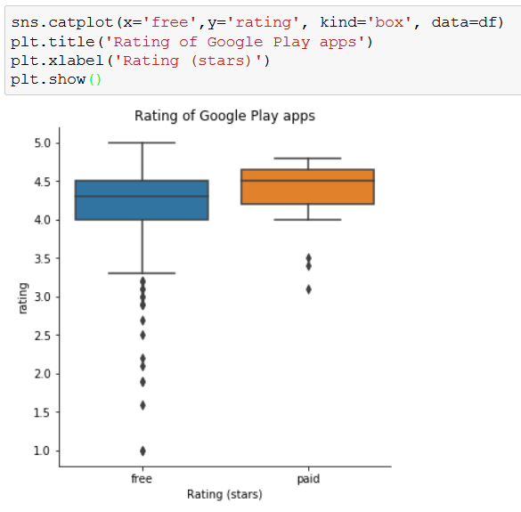
Seaborn: 2 syntaxes
Use column names from data frame
Specific functions for each plot type
Simple and quick
Use column names from data frame
Generic functions (catplot = categorical plot)
Ideal for investigating relations
Next week!

Slide 20
Topics
Example
Course overview
Data cleaning and ‘munging’
Distributions
Sampling and the normal distribution

Slide 21
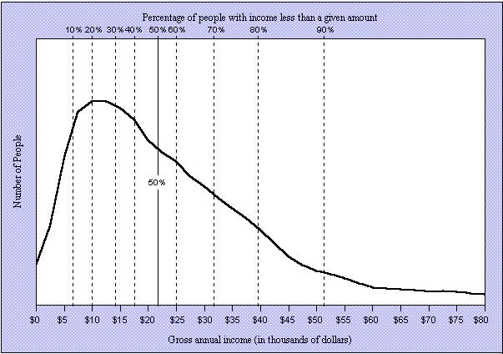
Distributions

Slide 22
Distributions
Central tendency
Variation
Shape

Slide 23
Mean, median and mode
Mean: well, it’s the mean
Influenced by extreme values
Median: middle value
Less influenced by extreme values
Two middle values: mean of those two
Mode: most frequent value
Multiple modes possible
Not always useful / defined

Slide 24
Standard deviation and variance
Variance: average of squared deviations from the mean
Sample:
For population divide by n
Standard deviation

Slide 25
Example
Mean = 5 | Deviation from mean | Squared deviation from mean
2 | -3 | 9
5 | 0 | 0
8 | 3 | 9
Sum |  | 18
var (pop.) |  | 18/n = 18/3 = 6
var (sample) |  | 18/(n-1) = 18/2 = 9
sd (pop.) |  | √6 ≈ 2.45
sd (sample) |  | √9 = 3

Slide 26
Skew
Mean Median Mode
Left skewed
Skewness < 0
Mean < median < mode
Mode Median Mean
Right skewed
Skewness > 0
Mean > median > mode

Slide 27
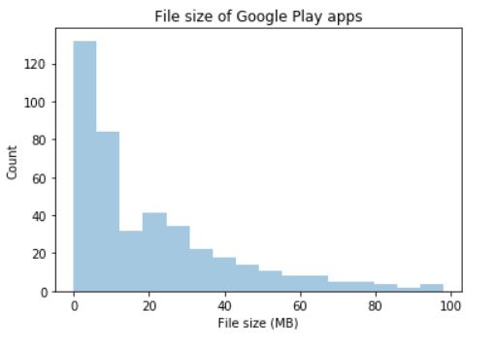
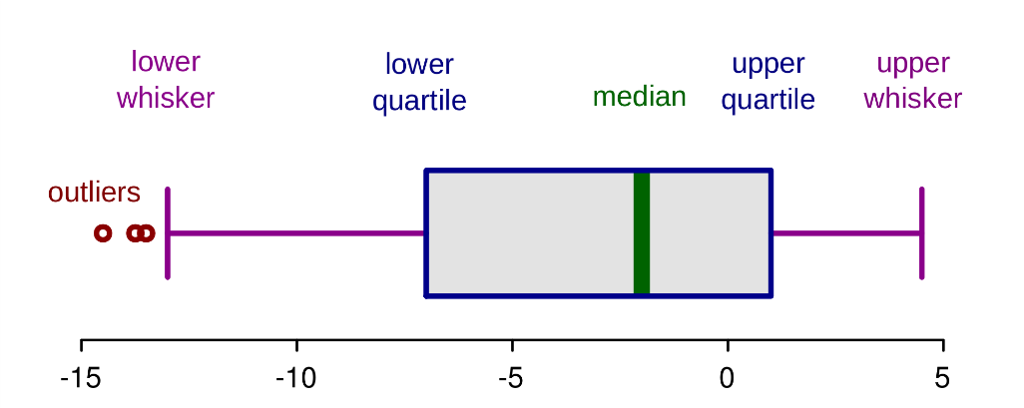
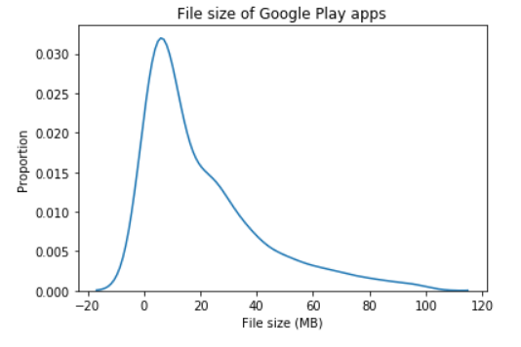
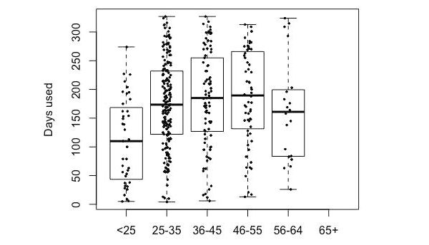
Plots
Histogram
Boxplot
Density plot (not the real data, actually a model!)
Boxplot with actual data superimposed

Slide 28
Exercise 2: distributions
See example Notebook: visualizing_distributions
Fill in the Google Sheets table (https://bit.ly/3pl32Qb) with your data. Please leave blank any columns that you feel uncomfortable answering.
Create a csv file from the data
Choose a different variable for each of the reports below:
Measures of variation and central tendency
Boxplot
Histogram
Density plot
Violin plot
For two of the variables, comment on modality and skewness, outliers
Notes:
Use Seaborn for all visualizations
Label your axes and give your figures a title
Plot the data points in some visualizations.
Extra challenge: investigate relations between variables (we will continue with this next week)

Slide 29
Image credit
Fitbit by eVidaSana.com (CC-BY)
France by Historicair (PD)
Random Forest by Venkata Jagannath (CC-BY-SA)
Boxplot by Ruediger85 (CC-BY-SA)
Density plot by Jake (CC-BY)
Normal distribution by Heds 1 (PD)

